Slide 1
Discussion 11: Balanced Search Trees, Tries, and Skip Lists
Christine Zhou

Slide 2
Agenda
Announcements
Balanced Search Tree Review
Problem 1
Tries Review
Problem 2
Skip Lists Review
Problem 3

Slide 3
Announcements
Midterm grades released!
You can submit regrades for a week, but we will not be accepting them at all afterwards!
Want to vent? Do you have comments/criticisms about the course? tinyurl.com/placetovent
Advising sessions are available at tinyurl.com/cs61b-advising
Feel free to email me if you would like to schedule a time!
Extra project OH
Monday 6-8PM in 273/275 Soda
Wednesday 6-8PM in 271/273 Soda
No office hours on Friday
Project milestone due Monday!
Project 2 due Thursday!
Discussion survey: tinyurl.com/czdisc11

Slide 4
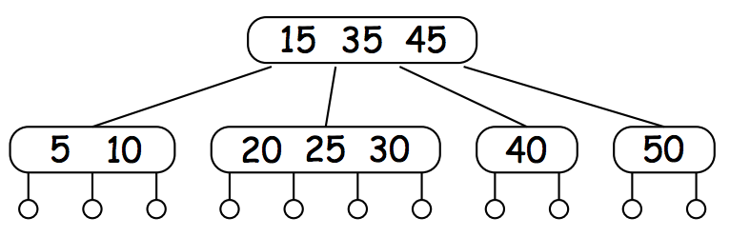
Balanced Search Trees
Bushy was better than spindly trees in terms of runtime
2-3-4 Trees! (also called 2-4 Trees)
Should still follow the BST property (less on the left, greater on the right)
Each node contains 1-3 elements with 2-4 children nodes
If we want to insert an element, we’ll traverse and put it in the corresponding leaf node
It’s possible that it will have more than 3 elements
Split the node, picking either of the middle elements to send up, this can happen recursively
Try inserting 7 and 27 into our 2-4 Tree!

Slide 5
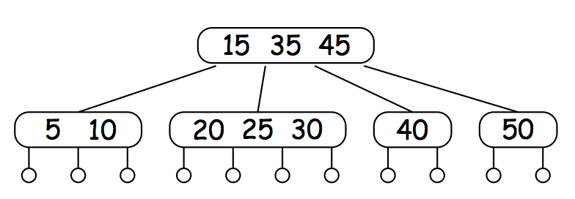
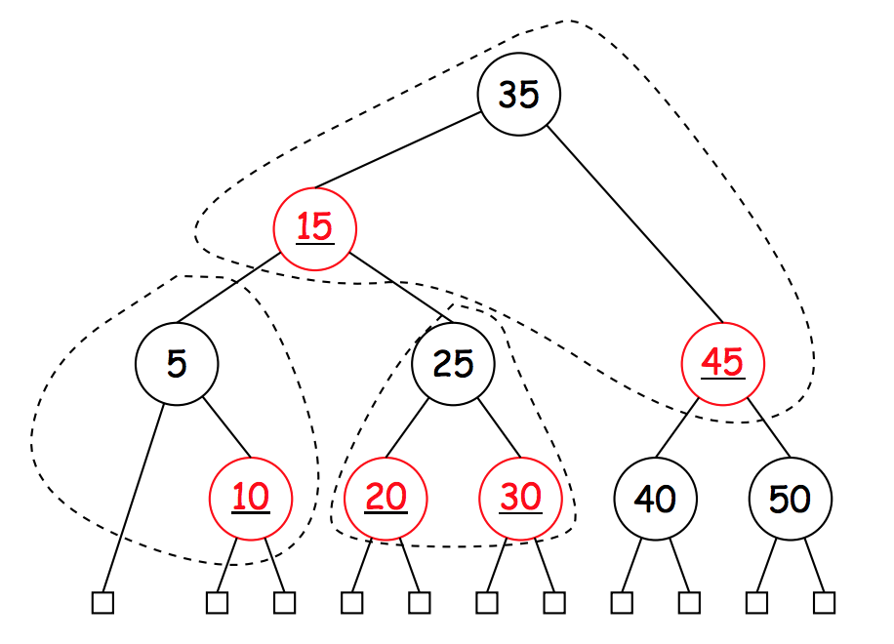
Red-Black Trees
A binary tree that colors nodes red and black
Any red nodes are in the same B-Tree node as its parent
Constraints:
1. Each node is (conceptually) colored red or black.
2. Root is black.
3. Every leaf node contains no data (null) and is black. This simplifies the algorithms a little bit.
4. Every leaf has same number of black ancestors.
5. Every internal node has two children.
6. Every red node has two black children.

Slide 6
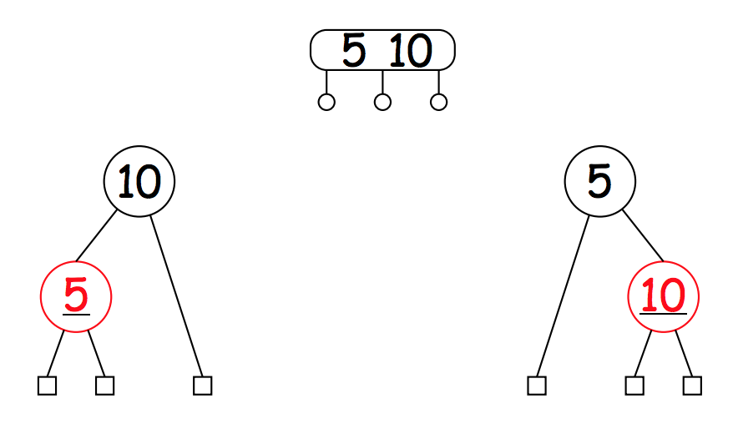
Left-Leaning Red Black Trees
We can represent nodes with two elements in two ways
Let’s just say that we’ll pick the left representation
If we are trying to represent a node with two elements, the red node will be “left leaning”

Slide 7
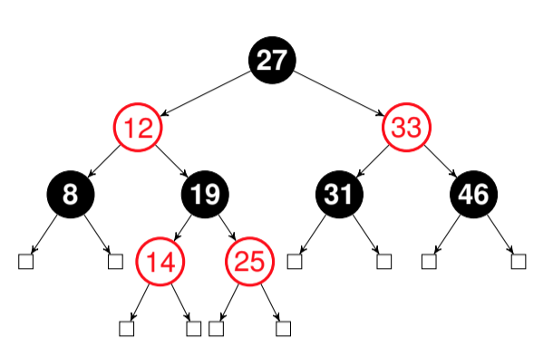
1 Balanced Search Trees
Convert the red-black tree into a 2-4 Tree.
Insert 13 into the 2-4 Tree. Choose the right middle to send up
Convert the resulting 2-4 Tree into a valid red-black tree. Make it left leaning

Slide 8
1 Balanced Search Trees
d) Given a (2, 4) tree containing N keys, how would you obtain the keys in sorted order in worst case O(N) time? We don’t need actual code—pseudo code or an unambiguous description will do.
e) If a (2,4) tree has depth h (that is, the leaves are at distance h from the root), what is the maximum number of comparisons done in the corresponding red-black tree to find whether a certain key is present in the tree?

Slide 9
Tries
What if we want to check if a particular word or prefix of a word is in our data structure?
Each node will represent a prefix, and the path to that node will consist of the characters of the prefix

Slide 10
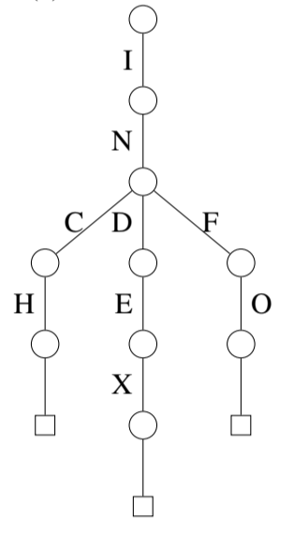
2 Tries
List the words encoded by the following trie.
Draw the trie after inserting the words “indent”, “inches”, and “trie”.

Slide 11
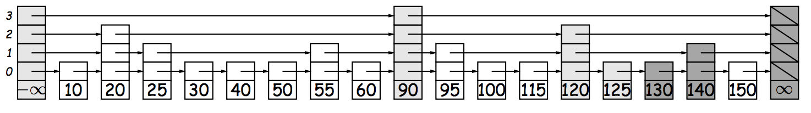
Skip Lists
A search structure, similar to binary search
Insert all elements into the skip list with a random “height”
All elements should appear in sorted order
To search for a value:
Start with the leftmost element in the set of tallest blocks, following the arrows
If you overshoot, go back to the one before overshooting, move one block down, and repeat
Let’s search for 130!

Slide 12
3 Skip Lists
Draw the resulting skip list after adding the following numbers at the specified random height. Then highlight the links used to find 148.

